Slide 1
Exoplanets and Solar System Planets Data Analysis & Visualization
Anton Zaitsev January 26, 2024

Slide 2
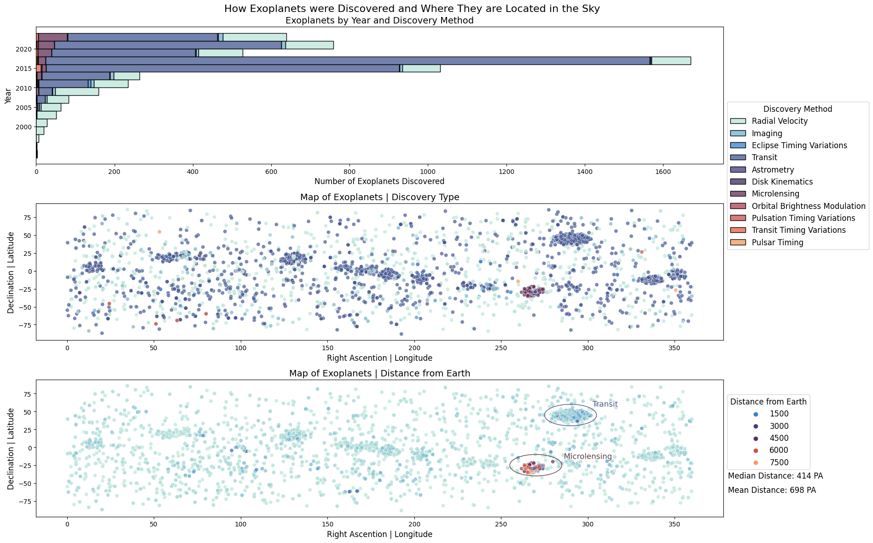

Slide 3
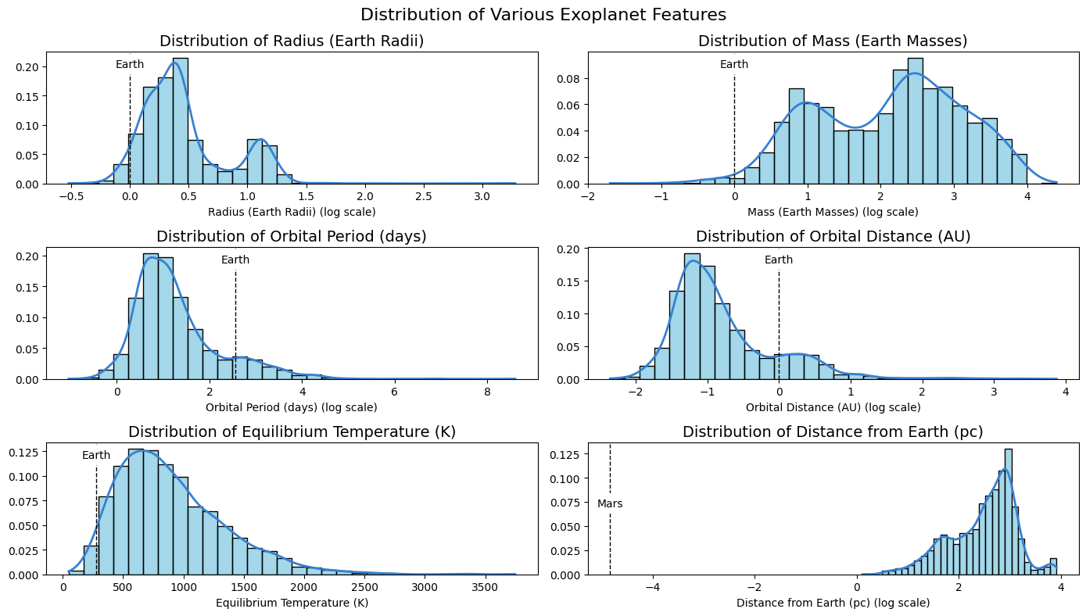

Slide 5
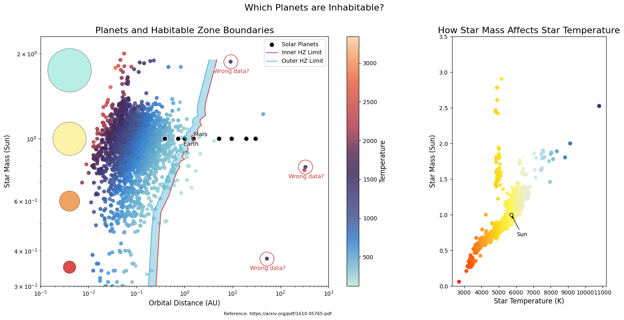

Slide 6
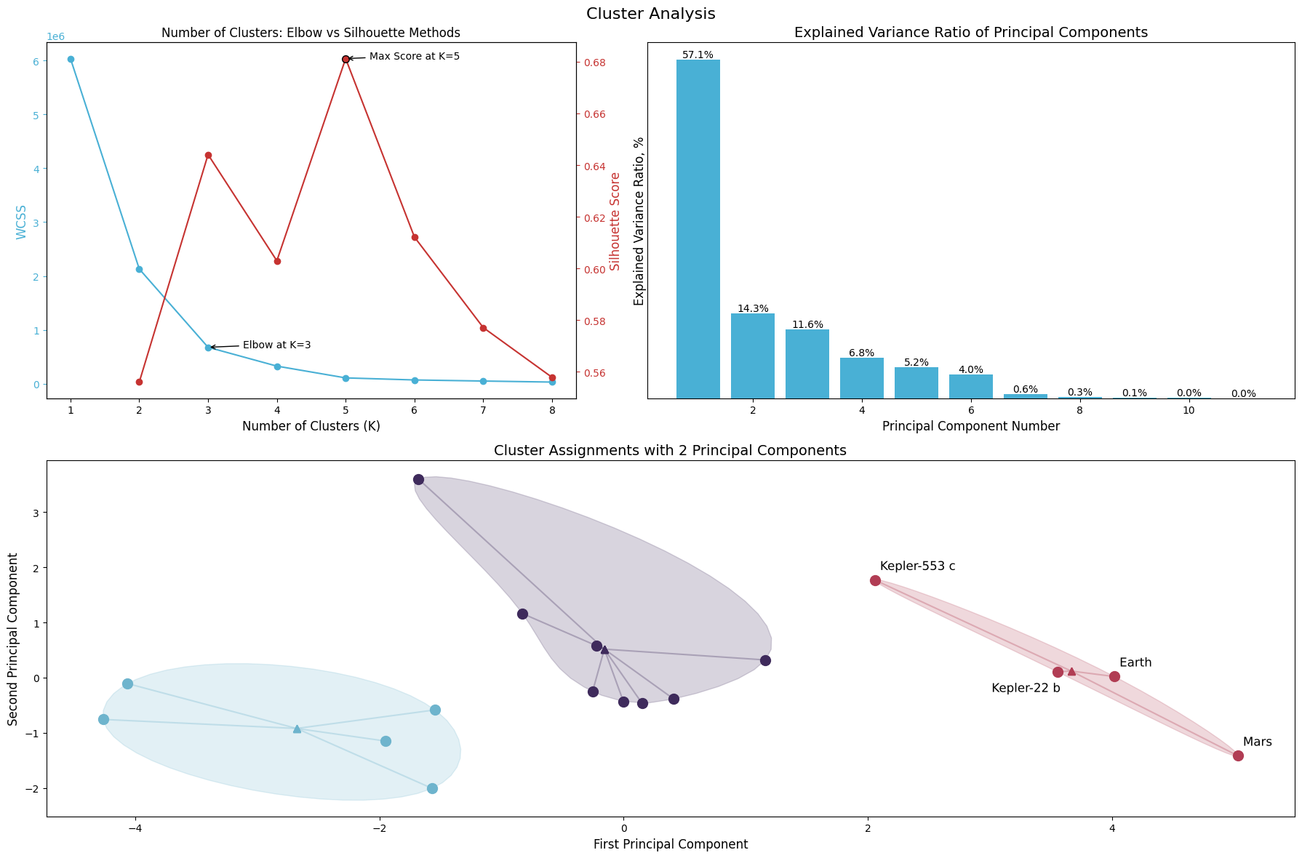

Slide 7
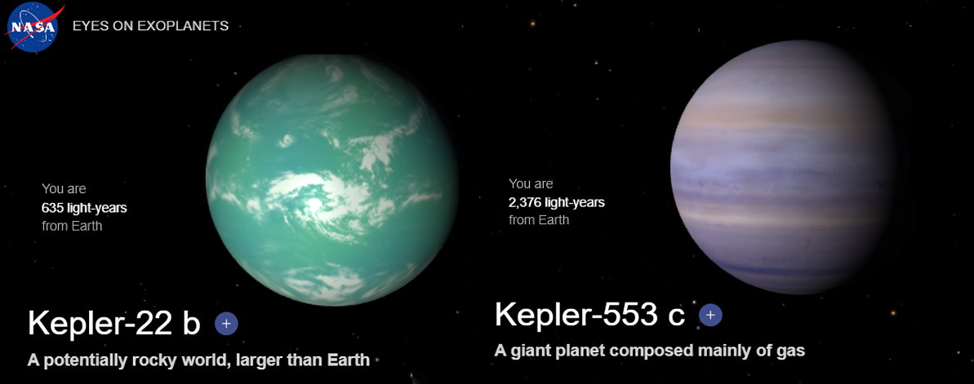
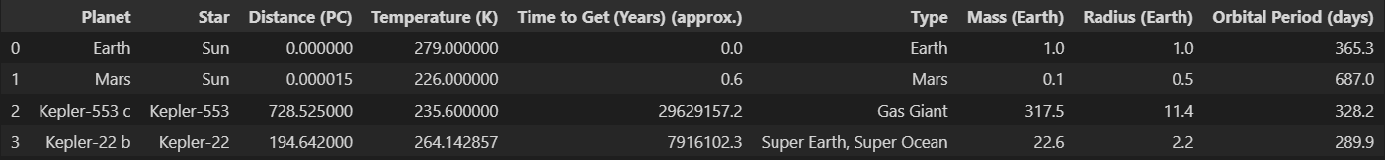

Slide 8
References
NASA Exoplanet Archive NASA Exoplanet Archive dataset contains information on confirmed planets outside of the Solar System, e.g. planet mass, radius, planet discovery method, orbital period, etc. Rows: 35131; Columns: 286 https://exoplanetarchive.ipac.caltech.edu/cgi-bin/TblView/nph-tblView?app=ExoTbls&config=PS
Solar System Major Bodies Data The Solar System Planets dataset contains information on major bodies inside the Solar System, including planets, such as Earth, Mars, Venus, etc. It includes information on body's attributes, such as mass, density, etc. Rows: 31; Columns: 265 https://www.kaggle.com/datasets/jaredsavage/solar-system-major-bodies-data
Equilibrium Temperatures for Solar Planets http://astro.vaporia.com/start/equilibriumtemperature.html This reference contains data (table) for equilibrium temperatures for planets inside the Solar System.
The Distances from the Solar Planets to the Earth https://promenade.imcce.fr/en/pages5/573.html This reference contains data (table) for the distances for planets inside the Solar System to Earth.
Habitable Zone Boundaries Calculation https://www.planetarybiology.com/calculating_habitable_zone.html We used this reference for the formula on how to calculate star inner and outer habitable zone boundaries.

Slide 9
References
Solar System Habitable Zone Boundaries https://www.britannica.com/science/habitable-zone This article provides information on the habitable zone of the Sun.
The Habitability of Planets Orbiting M-dwarf Stars https://arxiv.org/pdf/1610.05765.pdf In this paper, A. L. Shields, S. Ballard and J. A. Johnson provide a "comprehensive picture of the current knowledge of M-dwarf planet occurrence and habitability based on work done in this area over the past decade". This paper was only used as an inspiration for the 'Habitable Zone Boundaries' plot.
Sun Fact Sheet https://nssdc.gsfc.nasa.gov/planetary/factsheet/sunfact.html This page contains data on Sun.
Sun Age https://ui.adsabs.harvard.edu/abs/1989ApJ...339.1156G/abstract#:~:text=The%20age%20of%20the%20sun,4.49%20%2B%20or%20%2D%200.04%20Gyr. This page contains information about approximate Sun age.
Kepler-22 b and Kepler-553 c Kepler-22 b: https://exoplanets.nasa.gov/exoplanet-catalog/1599/kepler-22b/ Kepler-553 c: https://exoplanets.nasa.gov/exoplanet-catalog/6009/kepler-553-c/ This two pages contain information and animation on Kepler 22-b and HD 40307 g.

